Slide 1
UI/UX-fitness tracker and calorie counter

Slide 2
About
FitFabe combines Swiggy's extensive network of restaurants and seamless delivery services with Healthify's nutritional expertise and tracking capabilities. This integration allows users to access comprehensive nutritional information for menu items, empowering them to make informed dietary choices aligned with their health goals. By offering personalized meal recommendations based on individual preferences and nutritional requirements, FitFabe ensures that users can enjoy delicious meals while prioritizing their well-being.

Slide 3
ADVANTAGES
Integrate Healthify's nutritional database and analysis tools directly into the Swiggy app, allowing users to access comprehensive nutritional information for menu items.
Develop a user-friendly meal tracking feature within the FitFabe app, allowing users to log their dietary intake and monitor nutritional metrics such as calorie consumption, macronutrient distribution, and micronutrient intake.
Implement an AI-driven recommendation engine that analyzes user preferences, dietary requirements, and health goals to suggest personalized meal options from Swiggy's restaurant partners.Utilize machine learning algorithms to continuously refine recommendations based on user feedback and behavior, ensuring relevance and accuracy.

Slide 4
disadvantages
Furthermore, both platforms may encounter privacy and data security concerns, especially concerning the collection and usage of sensitive user data such as dietary preferences, health conditions, and location information. Ensuring robust data protection measures and transparent privacy policies is essential to maintain user trust and compliance with regulatory requirements.
In summary, while Swiggy and Healthify offer valuable services in the realms of food delivery and nutrition respectively, they face limitations related to delivery logistics, user engagement, data accuracy, and privacy concerns. Addressing these limitations through continuous innovation, quality assurance, and user-centric approaches will be crucial for enhancing the overall user experience and maximizing the impact of their offerings.

Slide 5
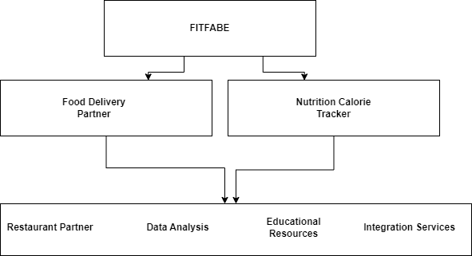
ARCHITECTURE DIAGRAM

Slide 6
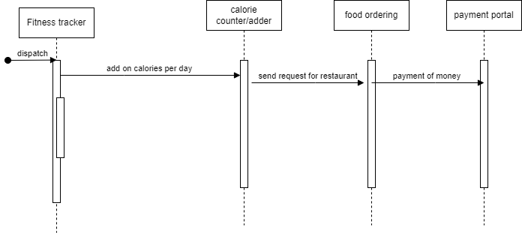
SYSTEMFLOW DIAGRAM

Slide 7
CONCLUSION
In conclusion, the collaboration between Swiggy and Healthify under the proposed name "FitFabe" represents a groundbreaking initiative aimed at revolutionizing the food delivery industry and promoting healthier living. By combining Swiggy's robust delivery infrastructure and extensive restaurant network with Healthify's nutritional expertise and tracking capabilities, FitFabe offers users a comprehensive platform for making informed dietary choices and adopting healthier eating habits.

Slide 8

Thank you

